Slide 1
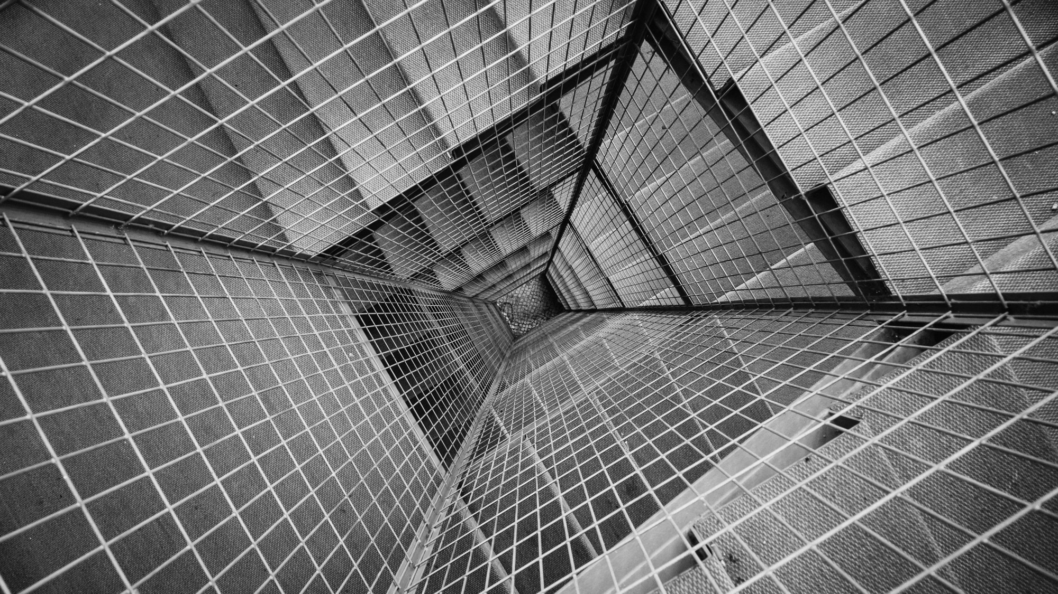
GLASS TYPE Classification
A Machine Learning Approach

Slide 2

INDEX
Use Case
Dataset
Data Quality Assessment
Exploratory Data Analysis
Feature Engineering
Performance Indicators
Model Selection
Results

Slide 3
USE Case
And Motivation
Many Glass manufacturing companies struggle to classify the glass types. These glass types are major criteria when it comes to the uses of the glass. Some glass types are particularly used for vehicles. Buildings and while others are used in things like headlamps and tableware. The main criteria for glass classification is the amount and percentage of particular elements like silicon, Iron, etc. and also the refractive index of the glass that is being manufactured. This Project aims to solve that problem by categorizing glass in its various types automatically by use of machine learning

Slide 4

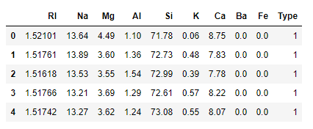
Dataset
Description
Dataset used in this project is obtained from the following site:
https://archive.ics.uci.edu/ml/datasets/Glass+Identification
Highlights:
The Dataset consists of 9 features and one target variable.
This contains 214 samples which are highly skewed
1 categorical target
9 Numerical features
Glass Classification Dataset by UCI

Slide 5
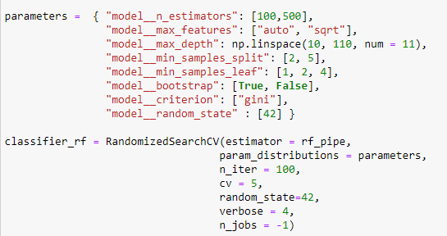
USE Case SOLUTION
What to expect?
I tried different ML models starting from the most simple ones to most complex like ANN sequential.
The model that gave best performance was ensemble model of Random Forest. The accuracy cam out to be 98.12% on trainset and on 82.50% test dataset

Slide 6

Data ASSESSMENT
How readily we can use this data
During the initial Assessment of data the following points were noticed:
The Features are all numerical and contain no missing values.
Initial Box plot suggest that there are quite a bit of outliers
The data is highly skewed and hence can cause problems in our models if used directly
Values of features are not scaled, some numbers are really high and while others really low

Slide 7
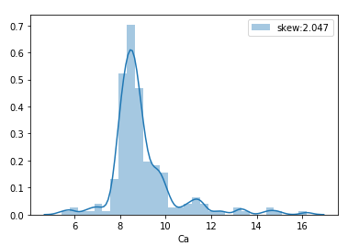
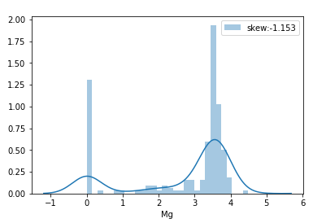
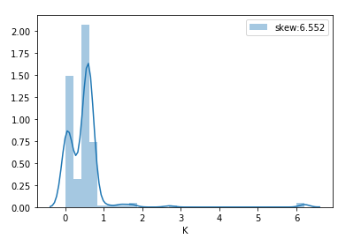
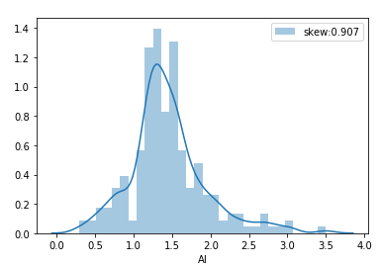
Exploratory data Analysis
Highlights:
The initial plots by univariate analysis suggest that the data is highly skewed and may cause problems in our models
Outlier detection by Tukey method gave us 14 rows which contained more than tow outliers. This was confirmed by box plot in the next slide
Checking the skewness of the data

Slide 8
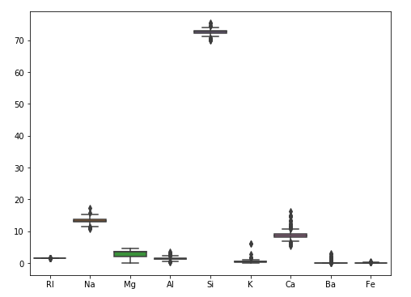
Exploratory data Analysis
Highlights:
Outliers are confirmed by the box plot of features
Also the mean value for Si was found to much higher, this was due to the fact that silicon is the main base material for glass
Further multivariate analysis was done by plotting heatmap on top of pearsons co-efficient of co-relation
Outlier detection

Slide 9
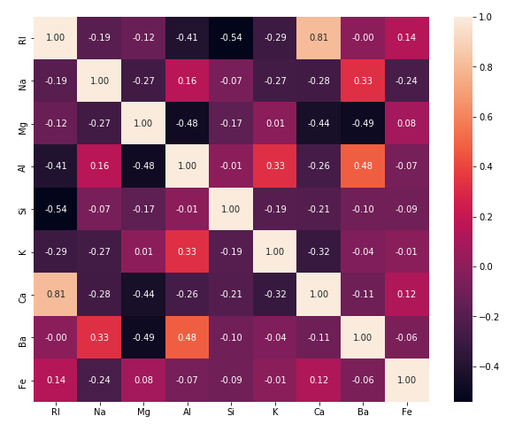
Exploratory data Analysis
Highlights:
Correlation heatmap that was produced is shown
The Ba and Al was found to have high positive correlation among themselves and similarly Ba and Na had positive high correlation
Correlation Heatmap

Slide 10
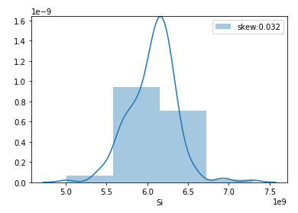
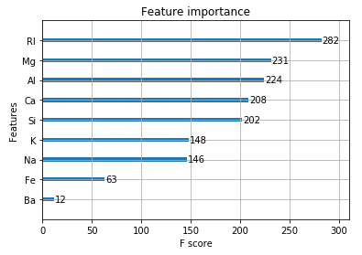
Feature Engineering
Making the features usable
Skewness reduced by using Boxcox transform
The Data that we had was highly skewed and hence we decided the transform it using Boxcox transform
For doing feature scaling we used Standard Scalar as a part of model pipeline
We also calculate the feature importance using XGBoost feature importance but no extremely dominant feature was found so it was safe to proceed

Slide 11
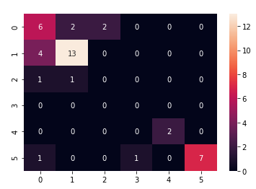
Performance Indicators
The performance indicators used for evaluation of the machine learning models in this problem:
Accuracy Score
Confusion Matrix
Sample of a confusion Matrix of a model

Slide 12
Model Selection
Which models were used
I started with some base models and then moved towards more advanced models. Models that I tested are:
Linear Regression
Random Forest Classifier
SVM
XGBoost Classifier
Artificial Neural Network (ANN- Sequential)

Slide 13
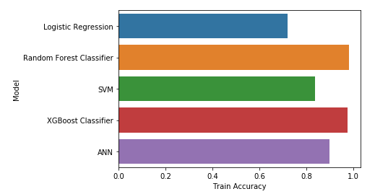
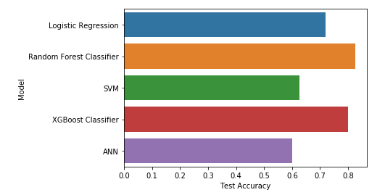
PERFORMANCE Comparison
ON TRAIN DATA
ON TEST DATA

Slide 14
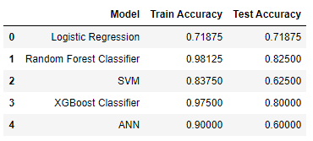
CONCLUSION
As we can see from table that Random Forest Classifier gave 82.50% accuracy on Test data, Hence we can use it in real life to predict the class of each glass type.
Comparison Table of various models

Slide 15
THANK YOU

